Slide 1



WELCOME TO

Slide 2

Objective of the Training
Become a Full Stack developer by gaining all the skills required to work with front-end and back-end technologies.

Slide 3

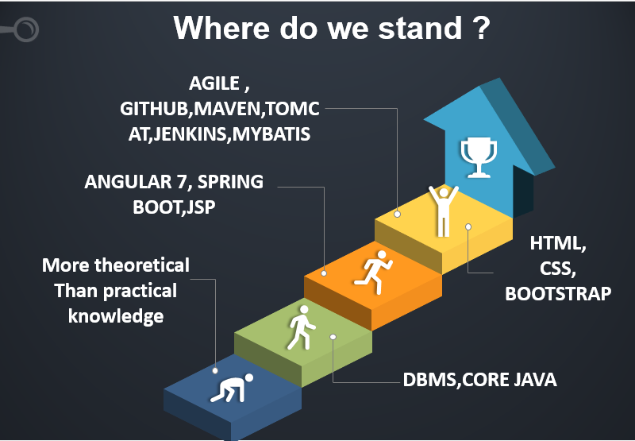

Slide 4
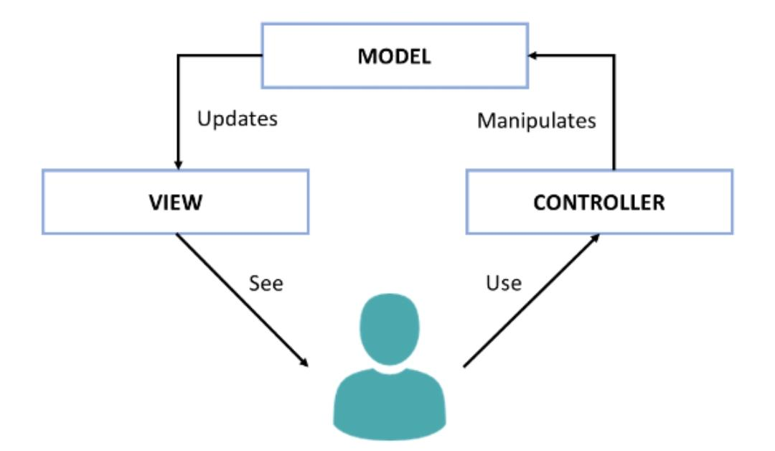
ER Diagram

Slide 5
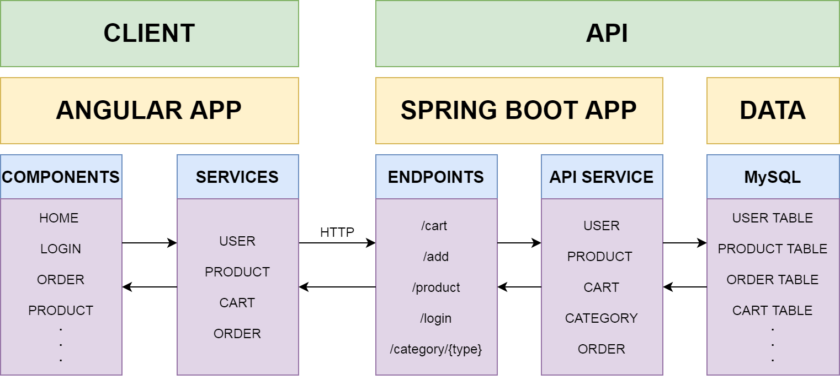
Full Stack Architecture

Slide 6
Problem Definition
To develop an interactive Ecommerce Application where one can perform Online Shopping

Slide 7
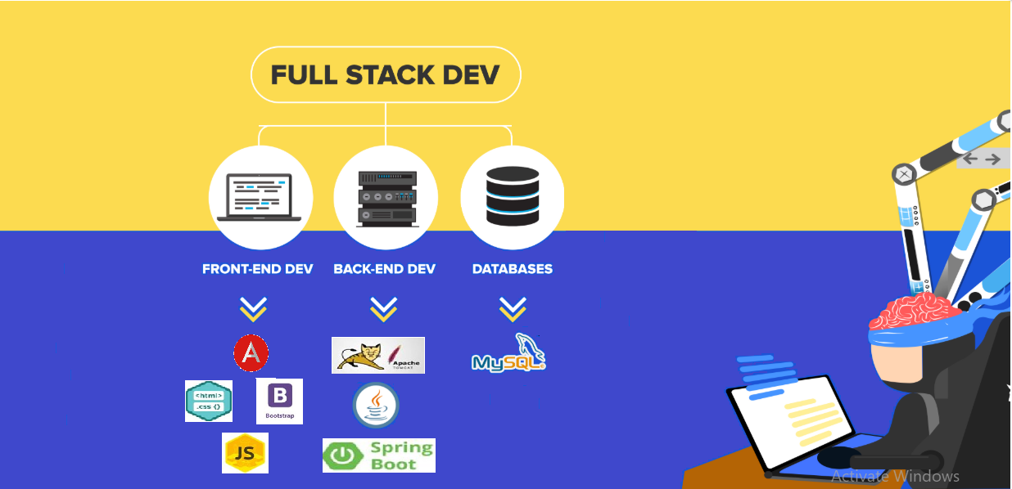

Slide 8
Project -E Commerce Web Application
E-Commerce Web Application allows us to perform all shopping related CRUDe operations.

Slide 9

SNAPSHOTS

Slide 10
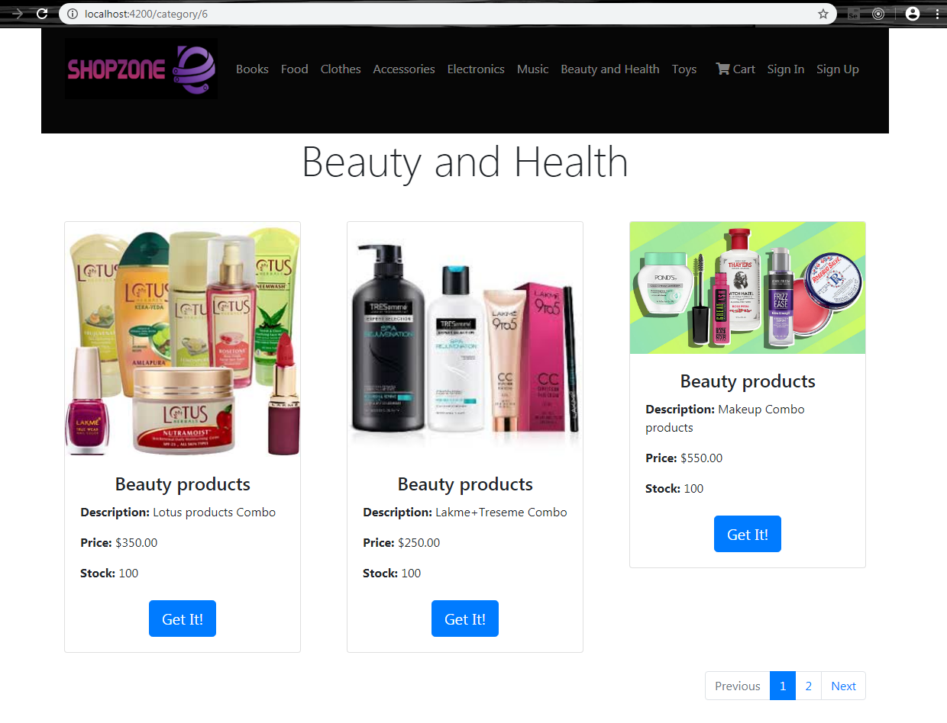
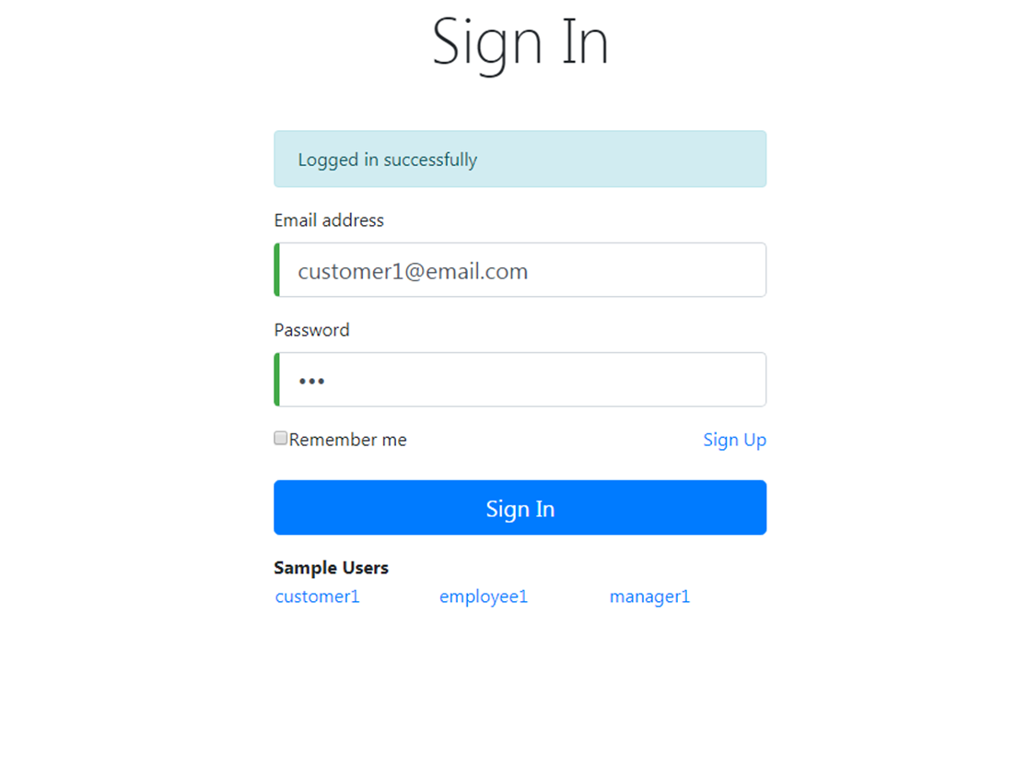

Slide 11
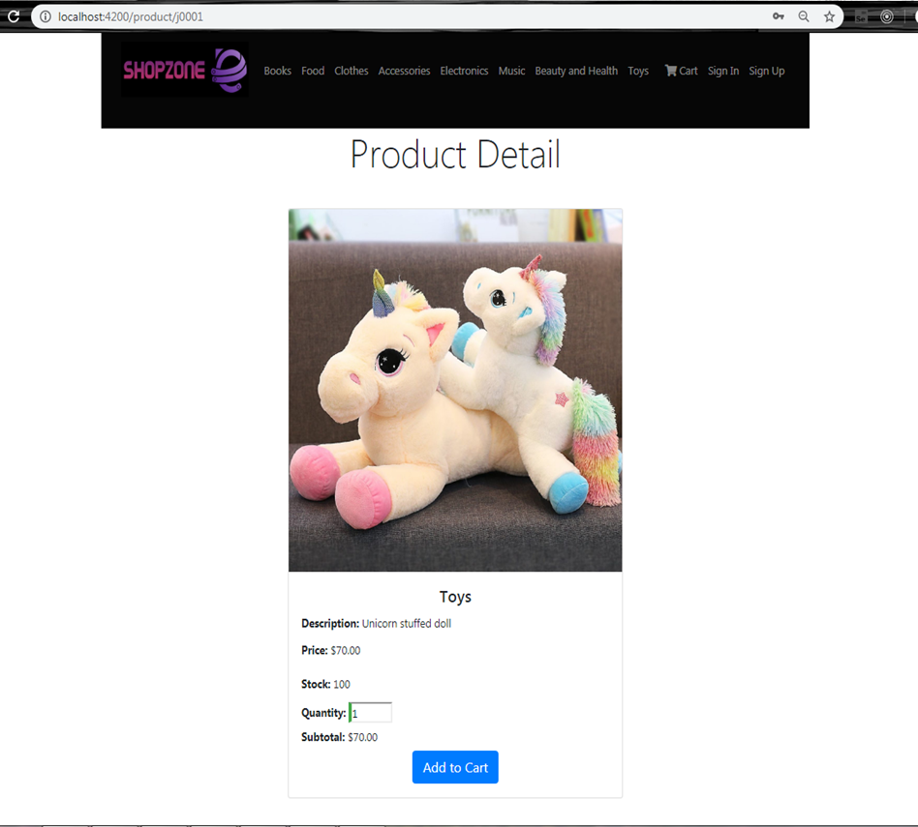
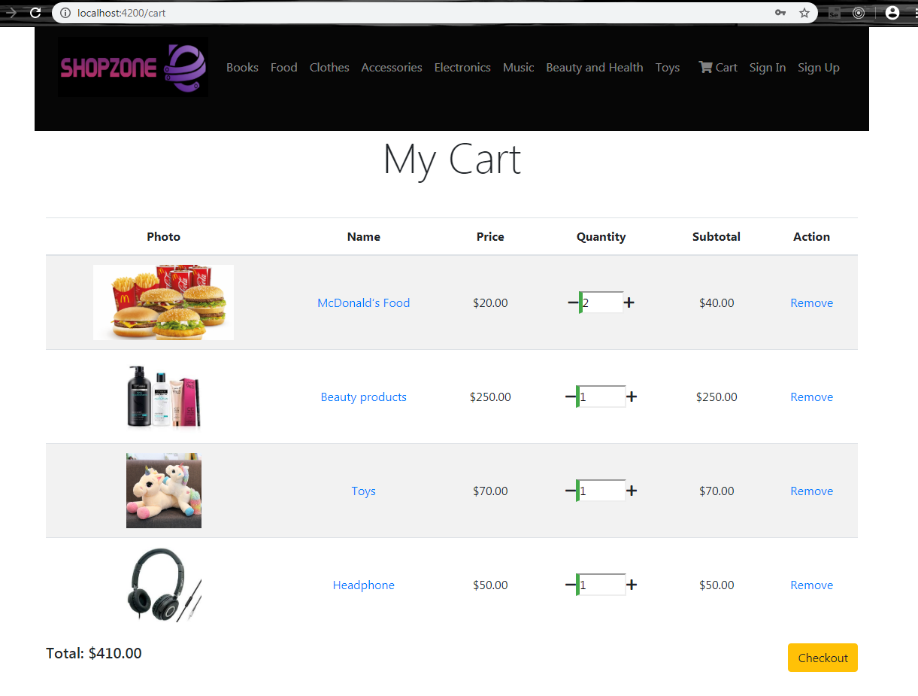

Slide 12
Conclusion
Today’s businesses must always strive to create the next best thing that consumers will want because consumers continue to desire their products, services etc. to continuously be better, faster, and cheaper. In this world of new technology, businesses need to accommodate to the new types of consumer needs and trends because it will prove to be vital to their business’ success and survival. E-commerce is continuously progressing and is becoming more and more important to businesses as technology continues to advance and is something that should be taken advantage of and implemented.

Slide 13

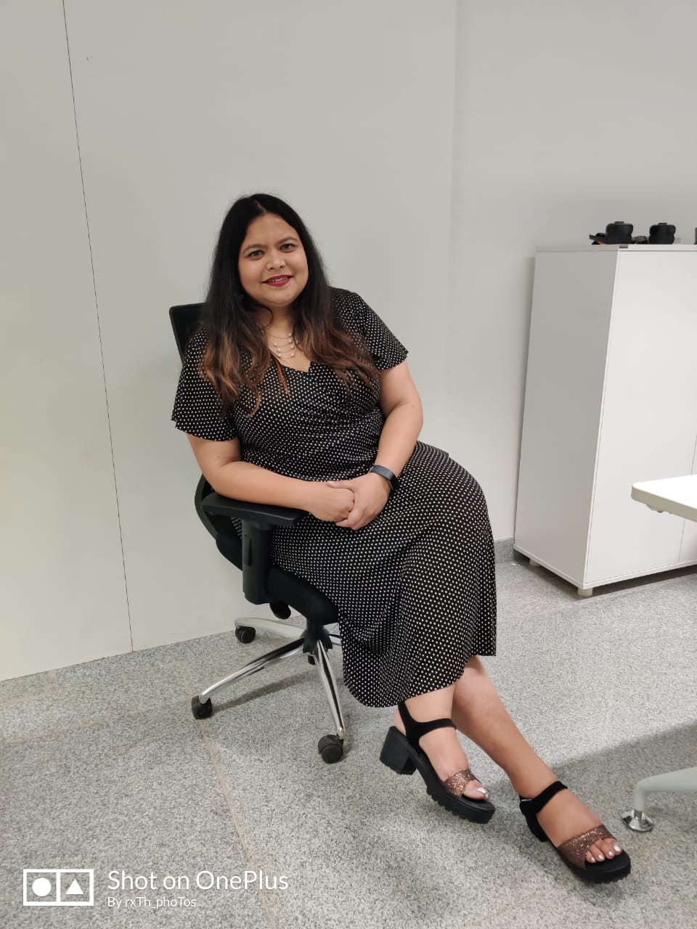



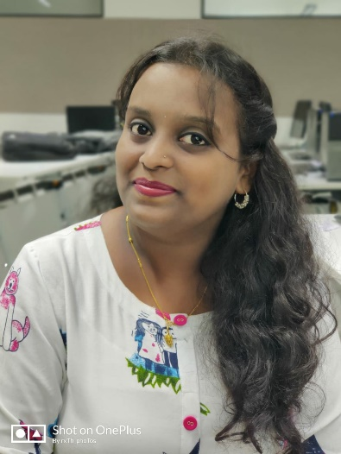
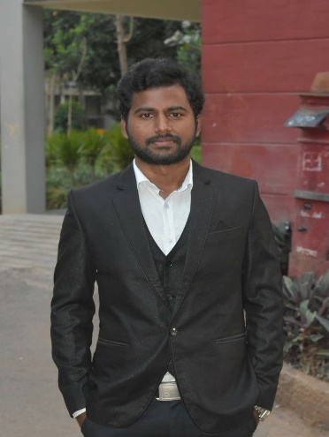
TRAINER
TEAM-IGNITE
Upasana
Bhyravi
Divya
Sangeeta
Santhosh
Ramya

Slide 14

THANK YOU

Slide 15
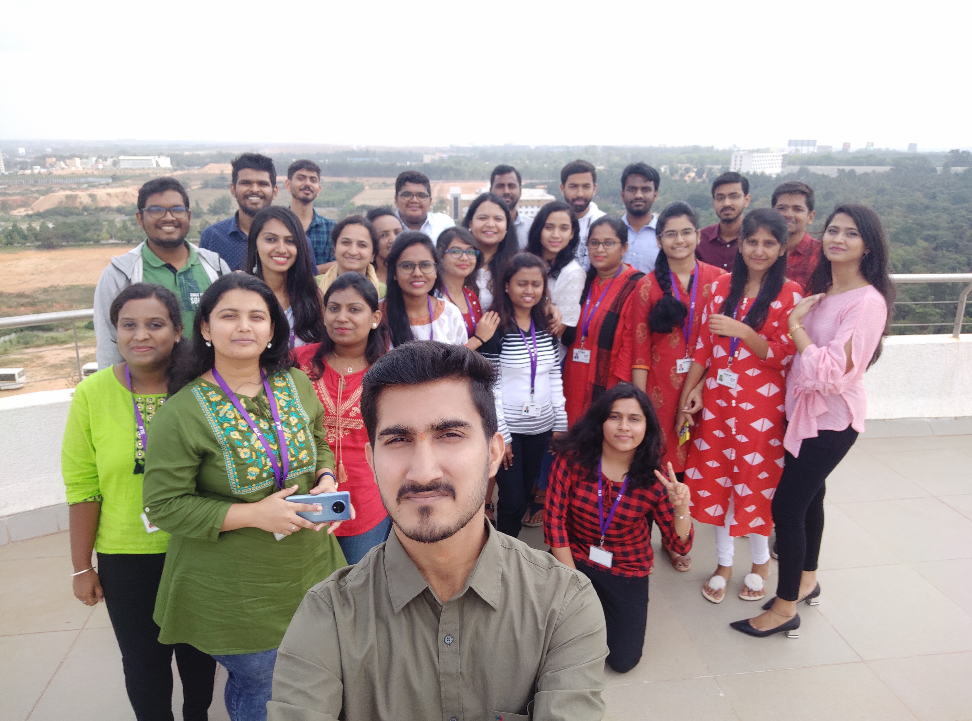

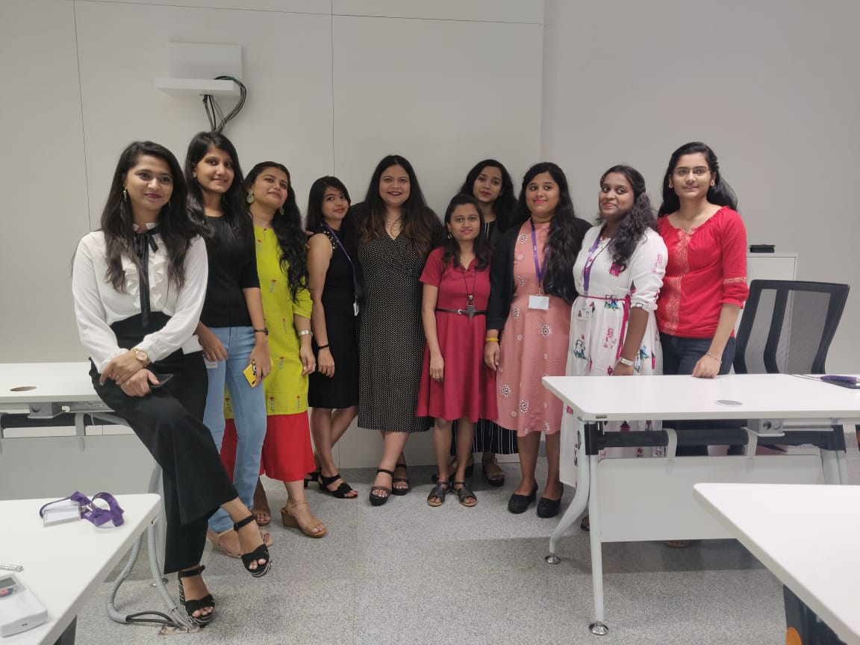
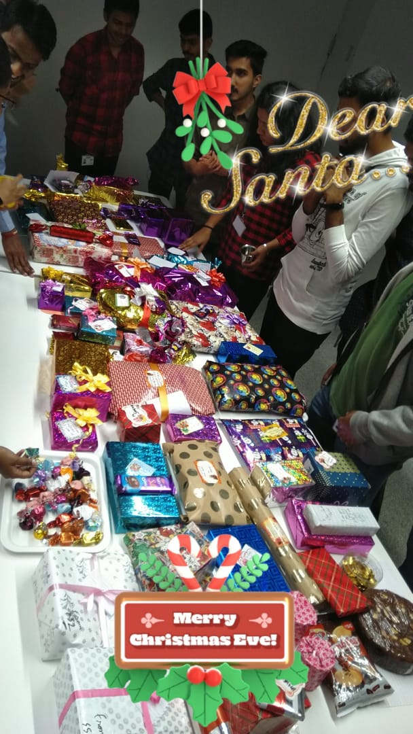
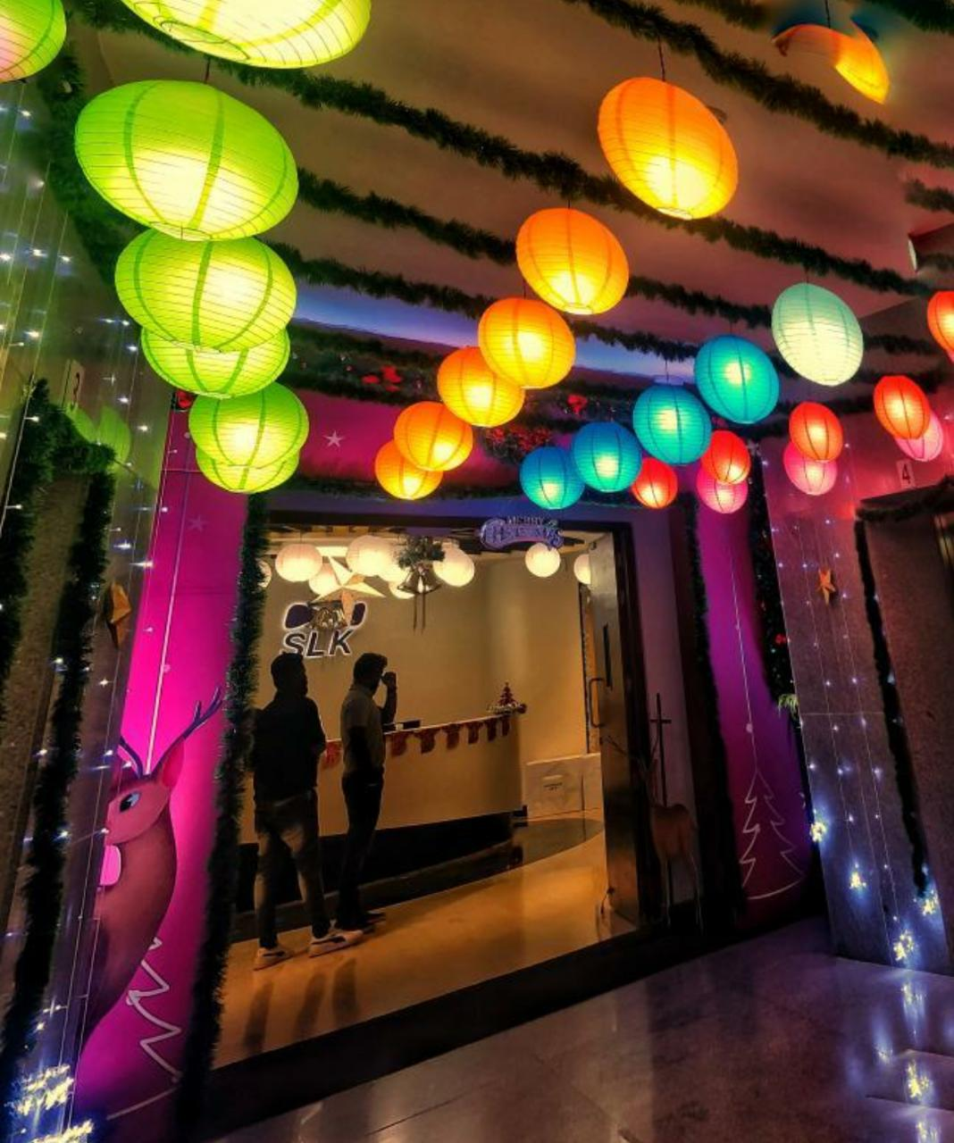
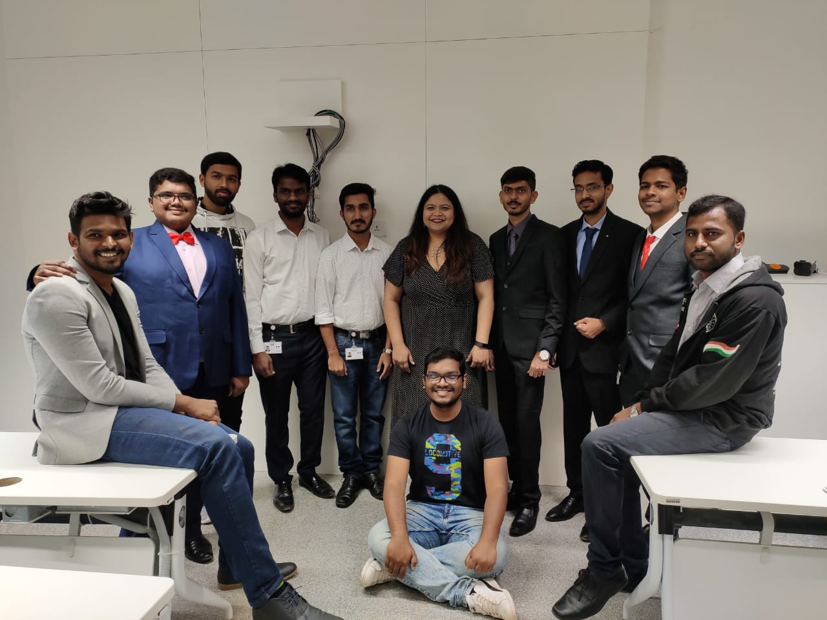
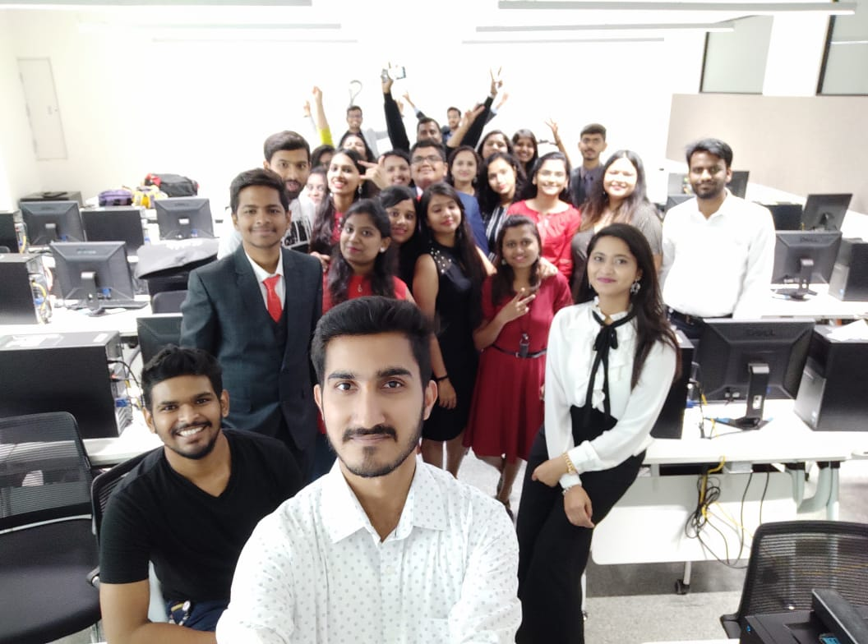
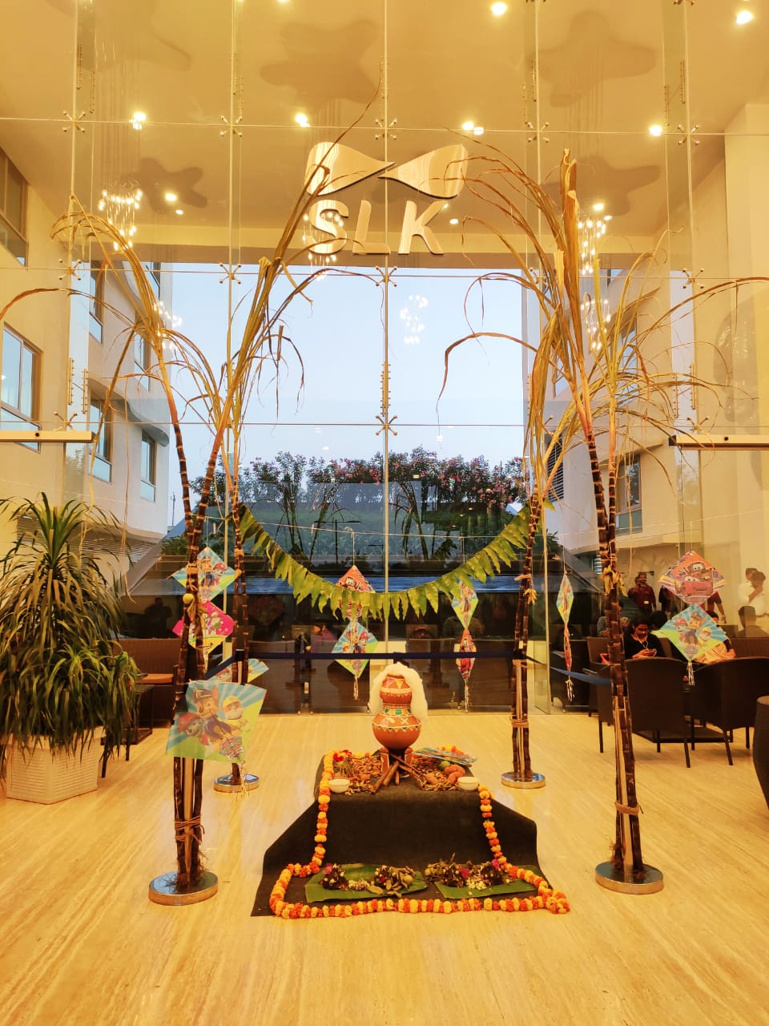
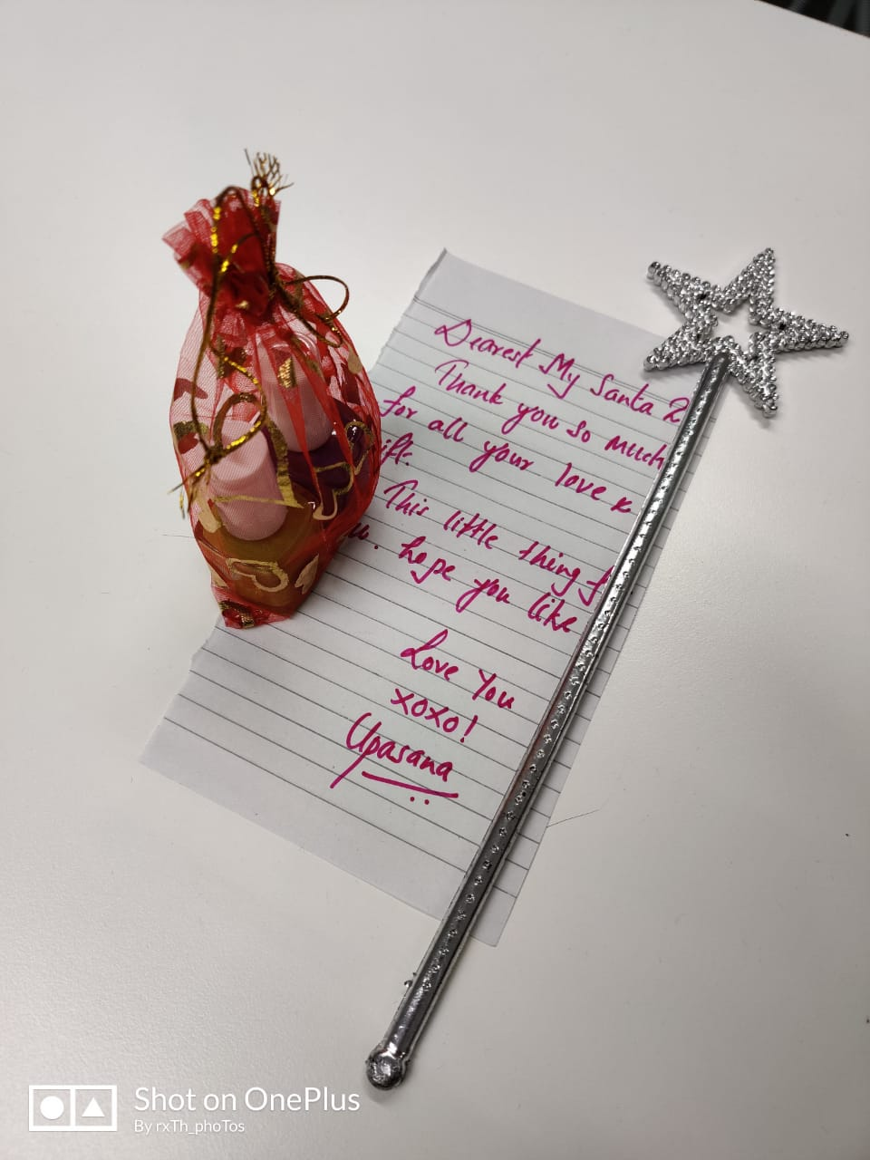
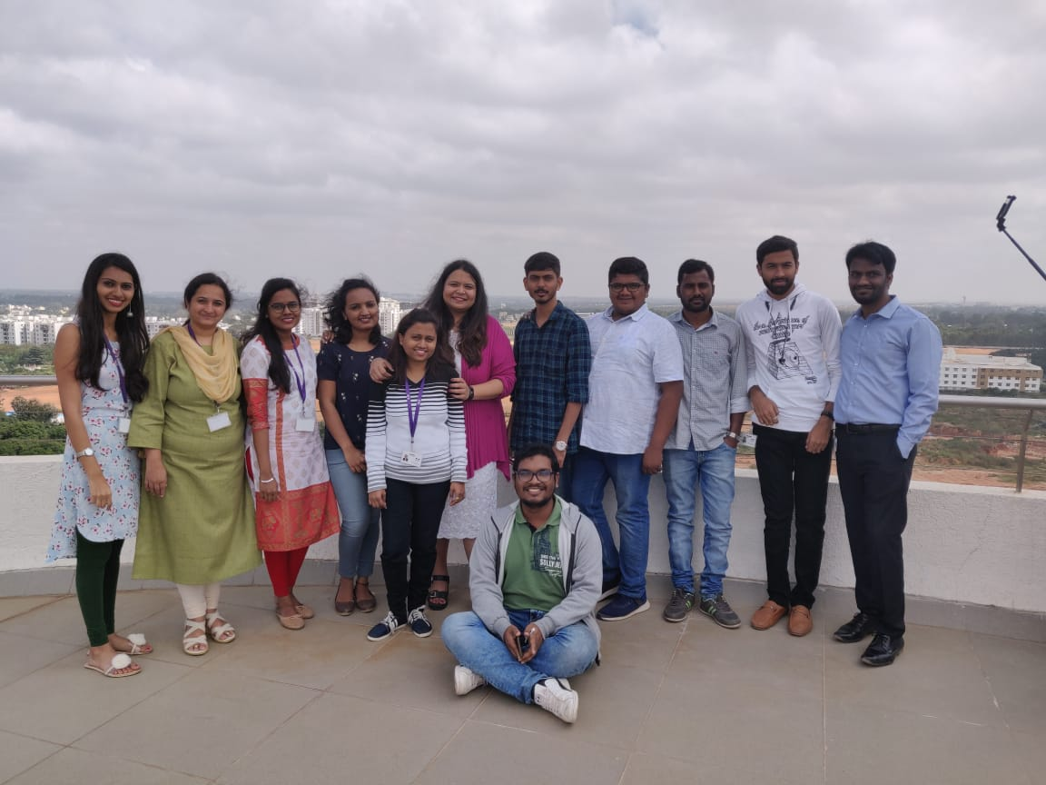
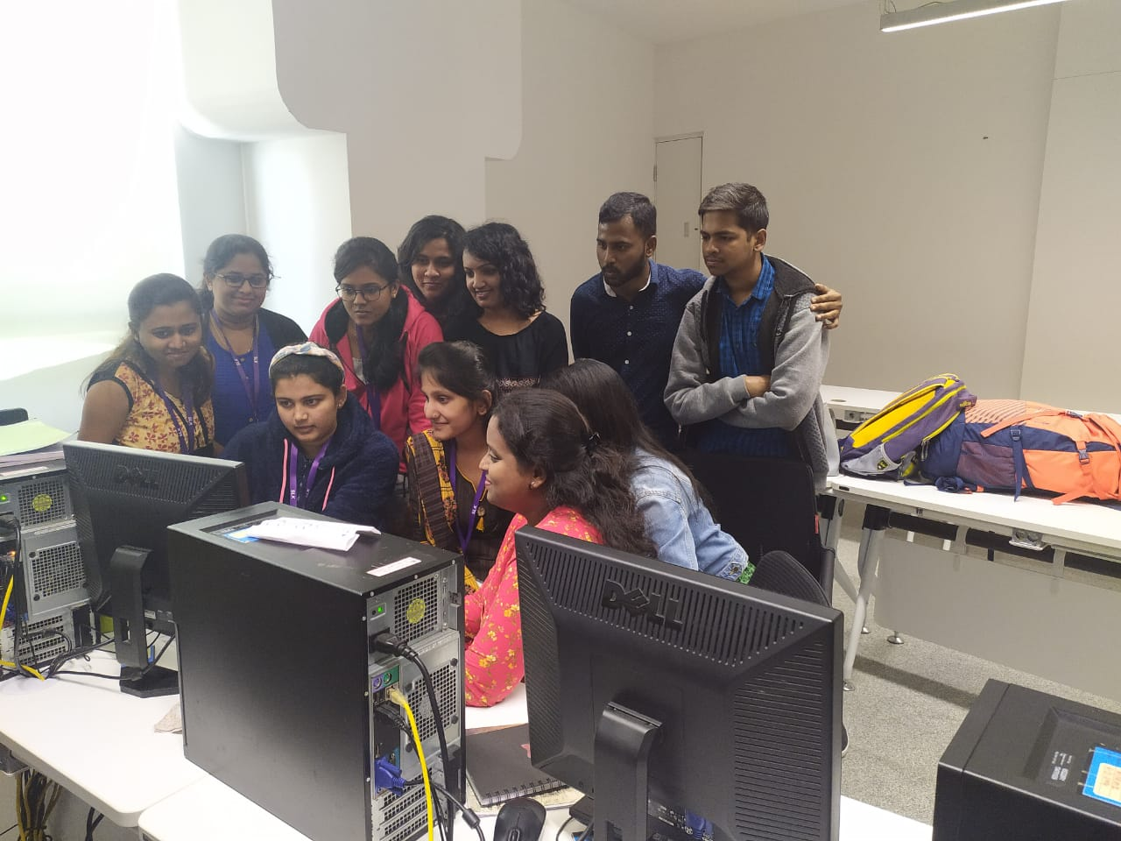
FUN AT WORK

